Slide 1
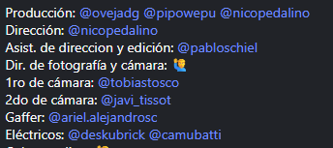
Publicidad 2024 - Yo: electrica - Para: Banco Chubut
Link: https://www.instagram.com/reel/DAbuY3ERHDU/?utm_source=ig_web_copy_link&igsh=MzRlODBiNWFlZA==

